Slide 1


Who wants to win millions ?
Millionaire Game

Slide 2

U.S. States
Map
U.S. States
Map
U.S. States
Map
U.S. States
Map
U.S. States
Map
$100
$100
$100
$100
$100
$200
$200
$200
$200
$200
$300
$300
$300
$300
$300
$400
$400
$400
$400
$400

Slide 3
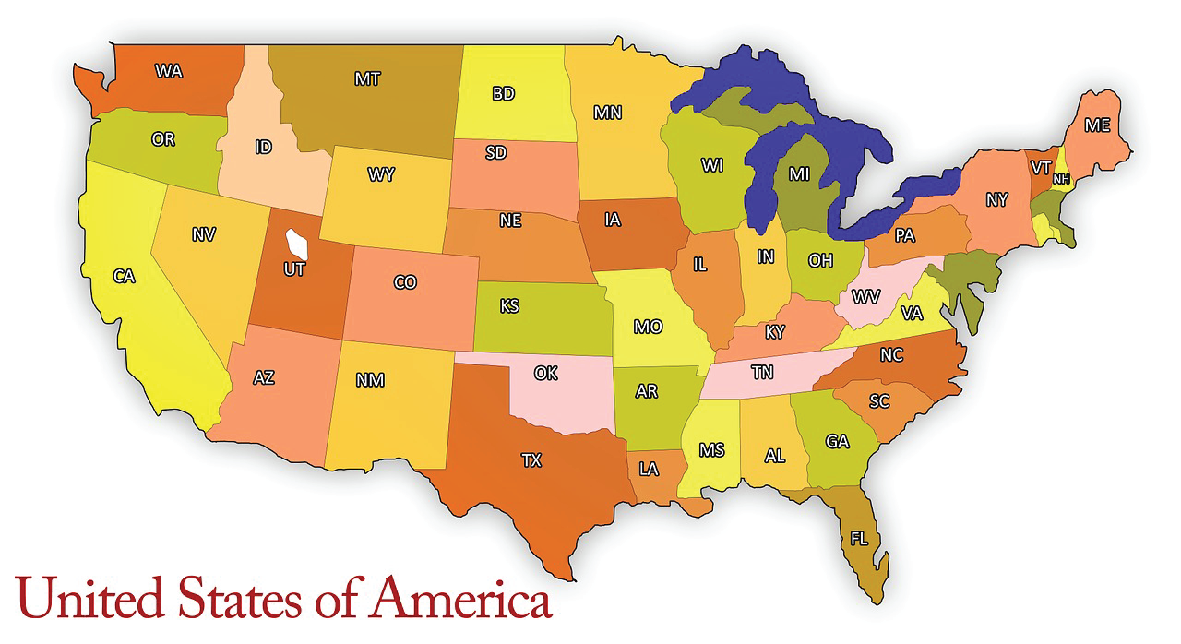
$100
What state is the arrow pointing to ?
New York

Slide 4
$200
What state is the arrow pointing to?
Vermont

Slide 5
$300
What state is the arrow pointing to?
Maine

Slide 6
What state is the arrow pointing to?
$400
Michigan

Slide 7
$100
What state is the arrow pointing to?
Wisconsin

Slide 8
What state is the arrow pointing to?
$200
Minnesota

Slide 9
What state is the arrow pointing to?
$300
North Dakota

Slide 10
$400
What state is the arrow pointing to?
Montana

Slide 11
$100
What state is the arrow pointing to?
Washington

Slide 12
$200
What state is the arrow pointing to?
Wyoming

Slide 13
What state is the arrow pointing to?
$300
Oregon

Slide 14
What state is the arrow pointing to?
$400
California

Slide 15
$100
What state is the arrow pointing to?
Nevada

Slide 16
What state is the arrow pointing to?
$200
Utah

Slide 17
What state is the arrow pointing to?
$300
Texas

Slide 18
What state is the arrow pointing to?
$400
Louisiana

Slide 19
What state is the arrow pointing to?
$100
Oklahoma

Slide 20
What state is the arrow pointing to?
$200
Missouri

Slide 21
What state is the arrow pointing to?
$300
Tennessee

Slide 22
What state is the arrow pointing to?
$400
Georgia

