Slide 1

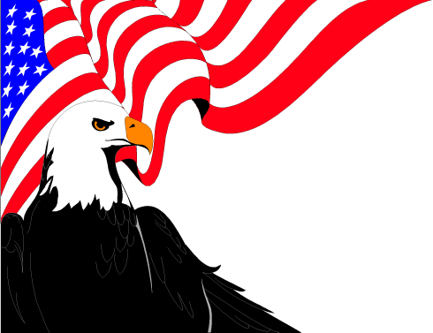
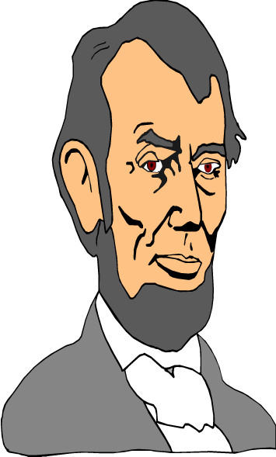
U.S. Presidents
Who is in the hidden picture? Be the first to find out.

Slide 2
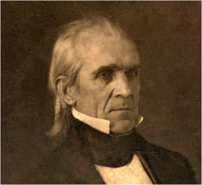
James K.
Polk
Remove

Slide 3
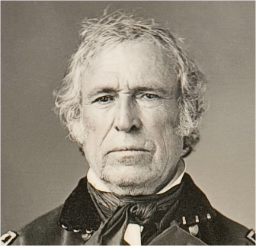
Zachary
Taylor
Remove

Slide 4
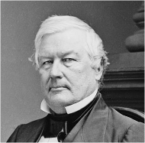
Millard
Fillmore
Remove

Slide 5
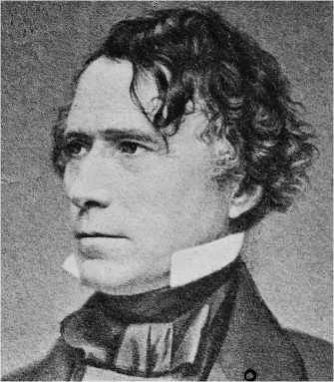
Franklin
Pierce
Remove

Slide 6
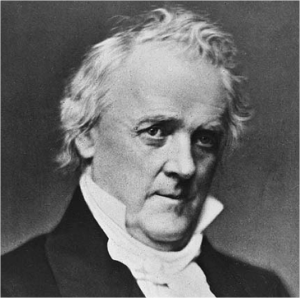
James
Buchanan
Remove

Slide 7
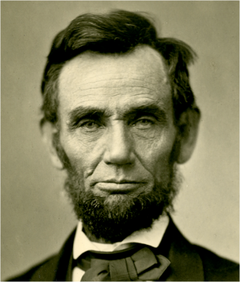
Abraham
Lincoln
Remove

Slide 8
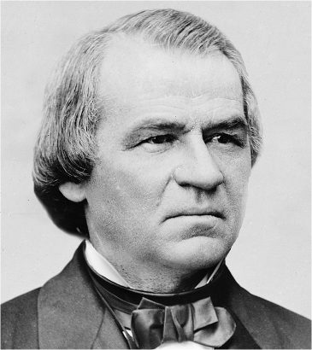
Andrew
Johnson
Remove

Slide 9
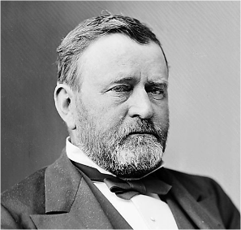
Ulysses S.
Grant
Remove

Slide 10
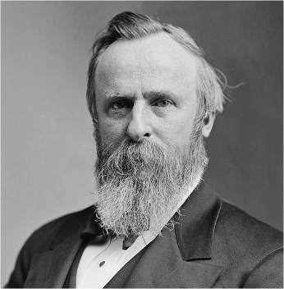
Rutherford B.
Hayes
Remove

Slide 11
Game Over

